Slide 1

Unit 4: NoSQL Database
NoSQL for Mere Mortals Dan Sullivan- 1st Edition, Pearson Education
Chapter 1 and 2

Slide 2
Unit 4: NoSQL Database
Introduction to NoSQL Database
Data management with distributed databases,
ACID and BASE
NoSQL Types:
Key-Value Database,
Document Database,
Column Family Database and
Graph Database
Comparison of relational databases and NoSQL

Slide 3
Introduction of NoSQL Databases
A database Management System provides the mechanism to store and retrieve the data.
There are different kinds of database Management Systems: 1. RDBMS (Relational Database Management Systems) 2. OLAP (Online Analytical Processing) 3. NoSQL (Not only SQL)

Slide 4
What are NoSQL databases ?
“NoSQL refers to an ill-defined set of mostly open-source databases, mostly developed in the early 21st century, and mostly not using SQL”

Slide 5
What is a NoSQL database?
NoSQL databases are different than relational databases like MySql.
In relational database you need to create the table, define schema, set the data types of fields etc before you can actually insert the data.
In NoSQL you don’t have to worry about that, you can insert, update data on the fly.
NoSQL database - really easy to scale and they are much faster in most types of operations that we perform on database.
When you are dealing with huge amount of data then NoSQL database is your best choice.

Slide 6
Common Characteristics
Not using the relational model
Run well on clusters
Can handle huge amount of data
Open Source
Build for 21st century web access
Schema-less / schema-free
BASE (not ACID)

Slide 7
Limitations of Relational databases
In relational database we need to define structure and schema of data first and then only we can process the data.
Relational database systems provides consistency and integrity of data by enforcing ACID properties (Atomicity, Consistency, Isolation and Durability).
However in most of the other cases these properties are significant performance overhead and can make your database response very slow.
RDBMS don’t provide you a better way of performing operations such as create, insert, update, delete etc on this data.
On the other hand NoSQL store their data in JSON format, which is compatible with most of the today’s world application.

Slide 8
History of NoSQL Databases
In the mid-1990s, the internet gained extreme popularity, and relational databases simply could not keep up with the flow of information demanded by users,
As well as the larger variety of data types that occurred from this evolution.
This led to the development of non-relational databases, often referred to as NoSQL.
NoSQL databases can translate strange data quickly and avoid the rigidity of SQL by replacing “organized” storage with more flexibility.

Slide 9
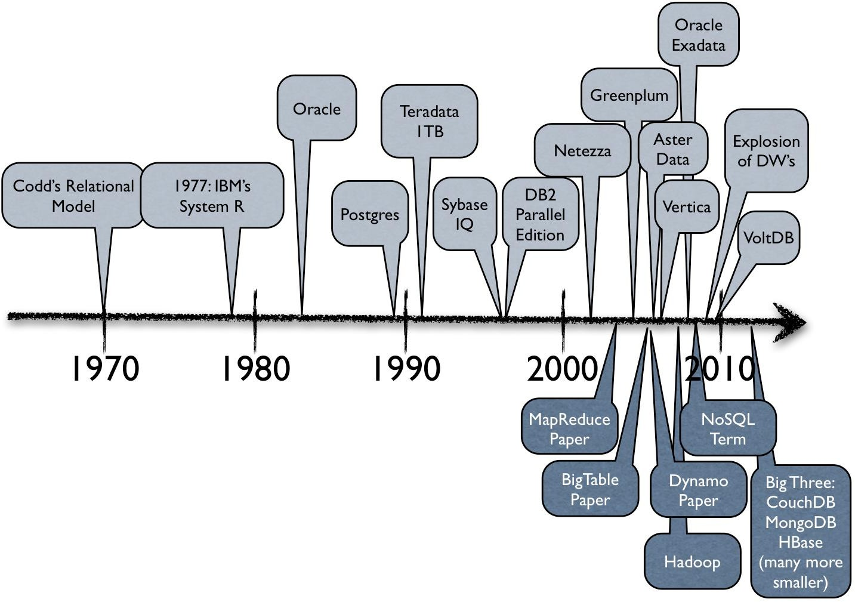
History of NoSQL Databases
1998- Carlo Strozzi use the term NoSQL for his lightweight, open-source relational database
2000- Graph database Neo4j is launched
2004- Google BigTable is launched
2005- CouchDB is launched
2007- The research paper on Amazon Dynamo is released
2008- Facebooks open sources the Cassandra project
2009- The term NoSQL was reintroduced

Slide 10
Features of NoSQL
Non-relational:
NoSQL databases never follow the relational model
Never provide tables with flat fixed-column records
Work with self-contained aggregates or BLOBs (binary large object)
Doesn't require object-relational mapping and data normalization
No complex features like query languages, query planners, referential integrity, joins, ACID

Slide 11
Features of NoSQL
Schema-free
NoSQL databases are either schema-free or have relaxed schemas
Do not require any sort of definition of the schema of the data
Offers heterogeneous structures of data in the same domain
Simple API
Offers easy to use interfaces for storage and querying data provided
APIs allow low-level data manipulation & selection methods
Text-based protocols mostly used with HTTP REST with JSON
Mostly used no standard based NoSQL query language
Web-enabled databases running as internet-facing services

Slide 12
Features of NoSQL
Distributed
Multiple NoSQL databases can be executed in a distributed fashion
Offers auto-scaling and fail-over capabilities
Often ACID concept can be sacrificed for scalability and throughput
Mostly no synchronous replication between distributed nodes Asynchronous Multi-Master Replication, peer-to-peer, HDFS Replication
Only providing eventual consistency
Shared Nothing Architecture. This enables less coordination and higher distribution.

Slide 13
Data Management with Distributed Databases
Before getting into the details of distributed databases, let’s look at a simplified view of databases in general.
Databases are designed to do two things: store data and retrieve data.
To meet these objectives, the database management systems must do three things:
Store data persistently
Maintain data consistency
Ensure data availability

Slide 14
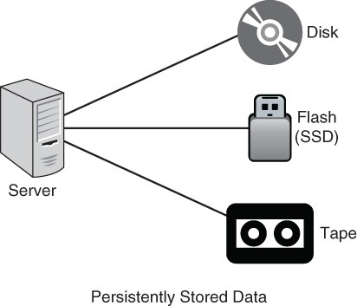
Store Data Persistently
Data must be stored persistently; that is, it must be stored in a way that data is not lost when the database server is shut down.
If data were only stored in memory—that is, RAM —then it would be lost when power to the memory is lost.
Only data that is stored on disk, flash, tape, or other long-term storage is considered persistently stored.
Indices are used for faster retrieval of data.

Slide 15
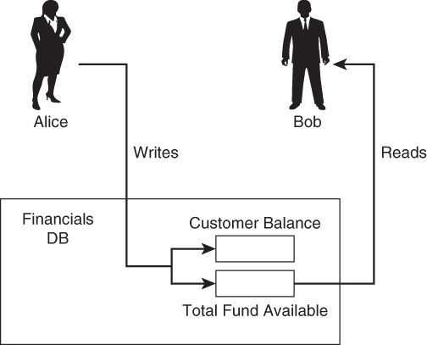
Maintain Data Consistency
It is important to ensure that the correct data is written to a persistent storage device.
If the write or read operation does not accurately record or retrieve data, the database will not be of much use.
Concurrency control mechanism is used for data consistency.

Slide 16
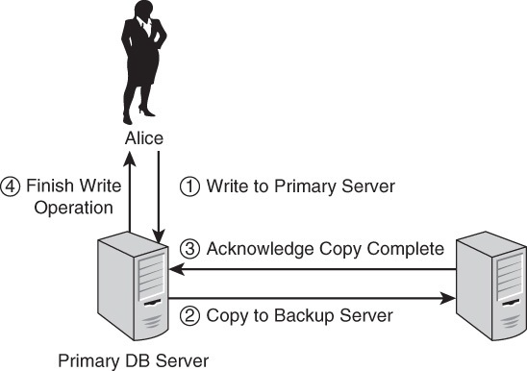
Ensure Data Availability
Data should be available whenever it is needed. This is difficult to guarantee.
One way to avoid the problem of an unavailable database server is to have two database servers.
One is used for updating data and responding to queries while the other is kept as a backup in case the first server fails. The server that is used for updating and responding to queries is called the primary server, and the other is the backup server

Slide 17
Ensure Data Availability
With data consistent on two database servers, you can be sure that if the primary database fails, you can switch to using the backup database and know that you have the same data on both.
When the primary database is back online, the first thing it does is to update itself so that all changes made to the backup database while the primary database was down are made to the primary database.
The advantage of using two database servers is that it enables the database to remain available even if one of the servers fails.

Slide 18
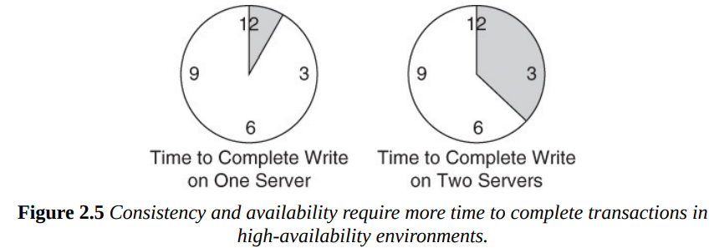
Ensure Data Availability
Because, in the case of a two-phase commit, a write operation is not complete until both databases are updated successfully, the speed of the updates depends on the amount of data written, the speed of the disks, the speed of the network between the two servers, and other design factors.
You can have consistent data, and you can have a high-availability database, but transactions will require longer times to execute than if you did not have those requirements.

Slide 19
Availability and Consistency in Distributed Databases
When two database servers must keep consistent copies of data, they incur longer times to complete a transaction.
This is acceptable in applications that require both consistency and high availability at all times. Financial systems at a bank, for example, fall into this category.
There are applications, in which the fast database operations are more important than maintaining consistency at all times. For example, an ecommerce site.
Imagine you are programming the user interface for an e-commerce site. How long should the customer wait after clicking on an “Add to My Cart” button? Ideally, the interface would respond immediately so the customer could keep shopping.
In this case, speed is more important than having consistent data at all times.

Slide 20
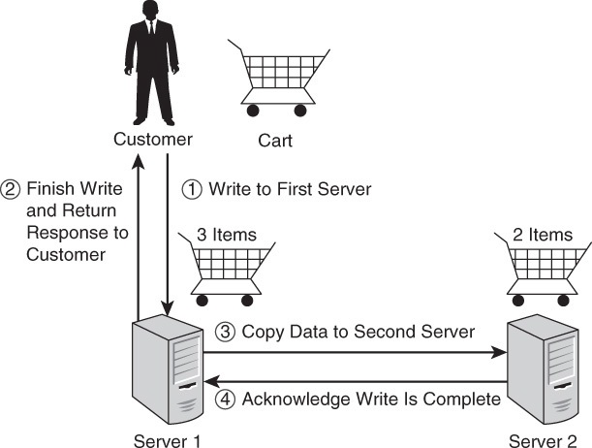
Availability and Consistency in Distributed Databases
One way to deal with this problem is to write the updates to one database and then copy the data to another server. There is a brief period of time when the customer’s cart on the two servers is not consistent, but the customer is able to continue shopping anyway.

Slide 21
Balancing Response Times, Consistency, and Durability
NoSQL databases often implement eventual consistency; that is, there might be a period of time where copies of data have different values, but eventually all copies will have the same value.
This raises the possibility of a user querying the database and getting different results from different servers in a cluster.
NoSQL databases often use the concept of quorums when working with reads and writes.
A quorum is the number of servers that must respond to a read or write operation for the operation to be considered complete.
When a read is performed, the NoSQL database reads data from, potentially, multiple servers. Most of the time, all of the servers will have consistent data. While the database copies data from one of the servers to the other servers storing replicas, the replica servers may have inconsistent data.

Slide 22
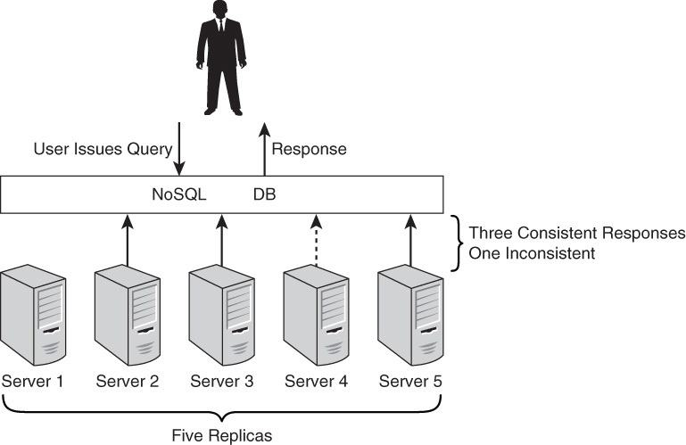
Balancing Response Times, Consistency, and Durability
One way to determine the correct response to any read operation is to query all servers storing that data. The database counts the number of distinct response values and returns the one that meets or exceeds a configurable threshold.

Slide 23
Balancing Response Times, Consistency, and Durability
You can vary the threshold to improve response time or consistency. If the read threshold is set to 1, you get a fast response. The lower the threshold, the faster the response but the higher the risk of returning inconsistent data.
Just as you can adjust a read threshold to balance response time and consistency, you can also alter a write threshold to balance response time and durability.
Durability is the property of maintaining a correct copy of data for long periods of time.
A write operation is considered complete when a minimum number of replicas have been written to persistent storage.

Slide 24
Brewer’s CAP Theorem
A distributed system can support only two of the following characteristics:
Consistency
Availability
Partition tolerance
Proven by Nancy Lynch et al. MIT labs.

Slide 25
Consistency
Consistency: Clients should read the same data. There are many levels of consistency.
Strict Consistency – RDBMS.
Tunable Consistency – Cassandra.
Eventual Consistency – Amazon Dynamo.
Client perceives (realize) that a set of operations has occurred all at once – Pritchett
More like Atomic in ACID transaction properties
Notes:
N : Number of nodes with a replica of data.
W: Number of nodes that must acknowledge the update.
R : Minimum number of nodes that succeeds read operation.
W + R > N Strong Consistency
W + R <= N Weak Consistency

Slide 26
Consistency
Strict consistency: is the strongest consistency model. Under this model, a write to a variable by any processor needs to be seen instantaneously by all processors
Tunable Consistency: means that you can set the consistency level for each read and write request. So, Cassandra gives you a lot of control over how consistent your data is.
You can allow some queries to be immediately consistent and other queries to be eventually consistent.
That means, in your application, the data that requires immediate consistency, you can create your queries accordingly and the data for which immediate consistency is not required, you can optimize for performance and choose eventual consistency.
Eventual Consistency: is a guarantee that when an update is made in a distributed database, that update will eventually be reflected in all nodes that store the data, resulting in the same response every time the data is queried.
Eventual consistency – data will become consistent at some point in time, with no guarantee when.

Slide 27
Consistency - Example
Consistent databases should be used when the value of the information returned needs to be accurate.
Financial data is a good example. When a user logs in to their banking institution, they do not want to see an error that no data is returned, or that the value is higher or lower than it actually is. Banking apps should return the exact value of a user’s account information. In this case, banks would rely on consistent databases.
Examples of a consistent database include:
Bank account balances
Text messages
Database options for consistency:
MongoDB
Redis
HBase

Slide 28
Availability
Availability: Data to be available.
Node failures do not prevent survivors from continuing to operate
Every operation must terminate in an intended response

Slide 29
Availability - Example
Availability databases should be used when the service is more important than the information.
An example of having a highly available database can be seen in e-commerce businesses. Online stores want to make their store and the functions of the shopping cart available 24/7 so shoppers can make purchases exactly when they need.
Database options for availability:
Cassandra
DynamoDB
Cosmos DB

Slide 30
Partition Tolerance
A partition is a communications break within a distributed system—a lost or temporarily delayed connection between two nodes.
Partition tolerance means that the cluster must continue to work despite any number of communication breakdowns between nodes in the system.
Partial Tolerance: Data to be partitioned across network segments due to network failures.
The system continues to operate despite arbitrary message loss.
Operations will complete, even if individual components are unavailable

Slide 31
Partition Tolerance
In normal operations, your data store provides all three functions.
But the CAP theorem maintains that when a distributed database experiences a network failure, you can provide either consistency or availability.
All other times, all three can be provided. But, in the event of a network failure, a choice must be made.
In the theorem, partition tolerance is a must. The assumption is that the system operates on a distributed data store, operates with network partitions.
Network failures will happen, so to offer any kind of reliable service, partition tolerance is necessary—the P of CAP. That leaves a decision between the other two, C and A.
When a network failure happens, one can choose to guarantee consistency or availability:
High consistency comes at the cost of lower availability.
High availability comes at the cost of lower consistency.

Slide 32
Consistency, Availability, and Partitioning: The CAP Theorem
The CAP theorem, also known as Brewer’s theorem after the computer scientist who introduced it.
It states that distributed databases cannot have consistency (C), availability (A), and partition protection (P) all at the same time.
Consistency, in this case, means consistent copies of data on different servers.
Availability refers to providing a response to any query.
Partition protection means if a network that connects two or more database servers fails, the servers will still be available with consistent data.

Slide 33
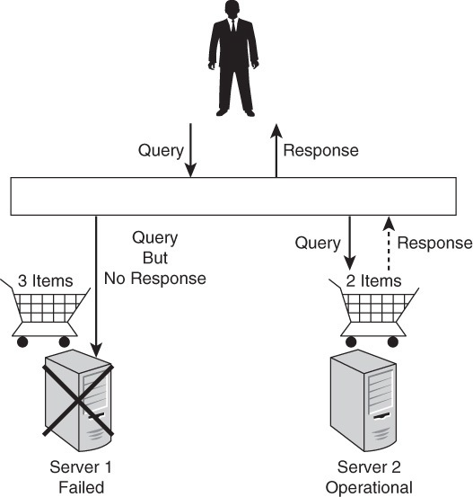
Example
The e-commerce shopping cart that it is possible to have a backup copy of the cart data that is out of sync with the primary copy. The data would still be available if the primary server failed, but the data on the backup server would be inconsistent with data on the primary server if the primary server failed prior to updating the backup server.

Slide 34
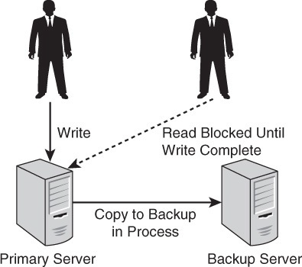
Example
Partition protection deals with situations in which servers cannot communicate with each other. This would be the case in the event of a network failure.
This splitting of the network into groups of devices that can communicate with each other from those that cannot is known as partitioning.

Slide 35
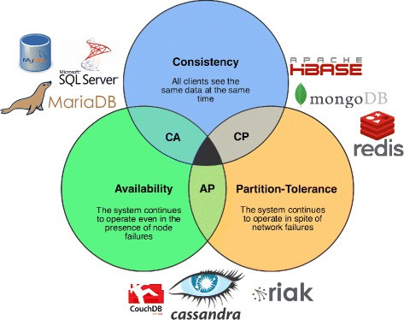
CAP theorem NoSQL database types

Slide 36
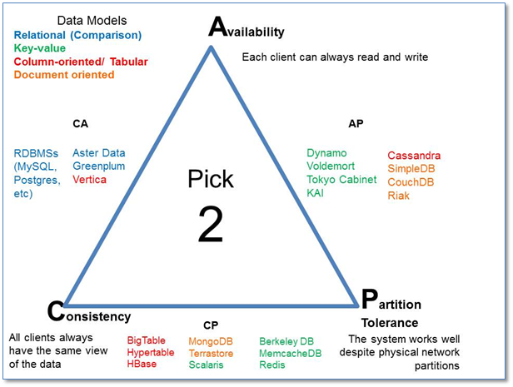
CAP Theorem

Slide 37
ACID and BASE
ACID: Atomicity, Consistency, Isolation, and Durability
A is for atomicity Atomicity, as the name implies, describes a unit that cannot be further divided. The set of steps is indivisible. You have to complete all of them as a single indivisible unit, or you complete none of them.
C is for consistency. In relational databases, this is known as strict consistency. In other words, a transaction does not leave a database in a state that violates the integrity of data.
I is for isolation. Isolated transactions are not visible to other users until transactions are complete. For example, in the case of a bank transfer from a savings account to a checking account, someone could not read your account balances while the funds are being deducted from your savings account but before they are added to your checking account.
D is for durability. This means that once a transaction or operation is completed, it will remain even in the event of a power loss. In effect, this means that data is stored on disk, flash, or other persistent media.
Relational database management systems are designed to support ACID transactions

Slide 38
ACID and BASE
BASE: Basically Available, Soft State, Eventually Consistent
BA is for basically available. This means that there can be a partial failure in some parts of the distributed system and the rest of the system continues to function.
For example, if a NoSQL database is running on 10 servers without replicating data and one of the servers fails, then 10% of the users’ queries would fail, but 90% would succeed.
NoSQL databases often keep multiple copies of data on different servers. This allows the database to respond to queries even if one of the servers has failed.
S is for soft state. Usually in computer science, the term soft state means data will expire if it is not refreshed. In NoSQL operations, it refers to the fact that data may eventually be overwritten with more recent data. This property overlaps with the third property of BASE transactions, eventually consistent.

Slide 39
ACID and BASE
E is for eventually consistent. This means that there may be times when the database is in an inconsistent state. For example, some NoSQL databases keep multiple copies of data on multiple servers. There is, however, a possibility that the multiple copies may not be consistent for a short period of time.
The time it takes to update all copies depends on several factors, such as the load on the system and the speed of the network.

Slide 40
ACID and BASE
Types of Eventual Consistency:
Casual consistency
Read-your-writes consistency
Session consistency
Monotonic read consistency
Monotonic write consistency

Slide 41
ACID and BASE
1. Casual consistency
Casual consistency ensures that the database reflects the order in which operations were updated.
For example, if Alice changes a customer’s outstanding balance to $1,000 and one minute later Bob changes it to $2,000, all copies of the customer’s outstanding balance will be updated to $1,000 before they are updated to $2,000.
2. Read-Your-Writes Consistency
Once you have updated a record, all of your reads of that record will return the updated value. You would never retrieve a value inconsistent with the value you had written.
For example, Alice updates a customer’s outstanding balance to $1,500. The update is written to one server and the replication process begins updating other copies. During the replication process, Alice queries the customer’s balance. She is guaranteed to see $1,500 when the database supports read your-writes consistency.

Slide 42
ACID and BASE
3. Session Consistency
Session consistency ensures read-your-writes consistency during a session. You can think of a session as a conversation between a client and a server or a user and the database.
As long as the conversation continues, the database “remembers” all writes you have done during the conversation.
If the session ends and you start another session with the same server, there is no guarantee it will “remember” the writes you made in the previous session.
4. Monotonic Read Consistency
Monotonic read consistency ensures that if you issue a query and see a result, you will never see an earlier version of the value.
For Example, Alice is updating customer balance. Currently it is $1500 she updates it to $2500. If Bob queries the database he will see the balance is $2,500 even if all the servers with copies of that customer’s balance have not updated to the latest value.

Slide 43
ACID and BASE
5. Monotonic Write Consistency
Monotonic write consistency ensures that if you were to issue several update commands, they would be executed in the order you issued them.
Let’s consider a variation on the outstanding balance example. Alice decides to reduce all customers’ outstanding balances by 10%.
Charlie, one of her customers, has a $1,000 outstanding balance. After the reduction, Charlie would have a $900 balance.
Charlie has just ordered $1,100 worth of material. His outstanding balance is now the sum of the previous outstanding balance ($900) and the amount of the new order ($1,100) or $2,000.

Slide 44
ACID and BASE
5. Monotonic Write Consistency (cont…)
Now consider what would happen if the NoSQL database performed Alice’s operations in a different order.
Charlie started with a $1,000 outstanding balance. Next, instead of having the discount applied, his record was first updated with the new order ($1,100).
His outstanding balance becomes $2,100. Now, the 10% discount operation is executed and his outstanding balance is set to $2,100–$210 or $1890.
Monotonic write consistency is obviously an important feature. If you cannot guarantee the order of operations in the database, you would have to build features into your program to guarantee operations execute in the order you expect.

Slide 45
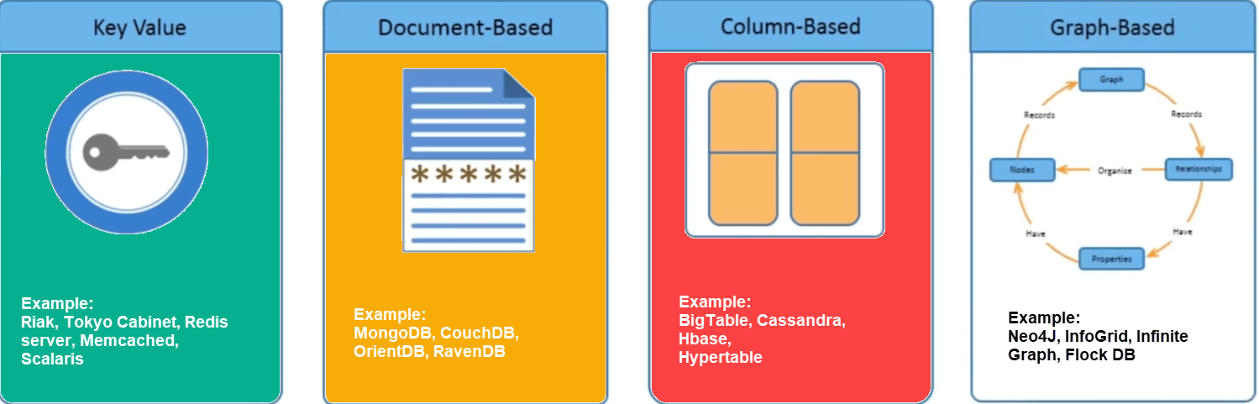
Types of NoSQL Databases
The most widely used types of NoSQL databases are
Key-value pair databases
Document databases
Column family store databases
Graph databases
Every category has its unique attributes and limitations. Users should select the database based on their product needs.

Slide 46
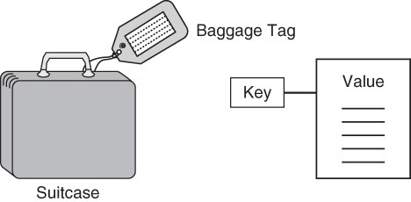
Key-Value Pair Databases
Key-value pair databases are the simplest form of NoSQL databases. These databases are modeled on two components: keys and values.
Keys - Keys are identifiers associated with values.
For example The tag you receive has an identifier associated with your luggage. With your tag, you can find your luggage more efficiently than without it.
The first customer checking bags on flight 1928 might be assigned ticket 1928.1 for her first bag and 1928.2 for her second bag. The second customer also has two bags and he is assigned 1928.3 and 1928.4

Slide 47
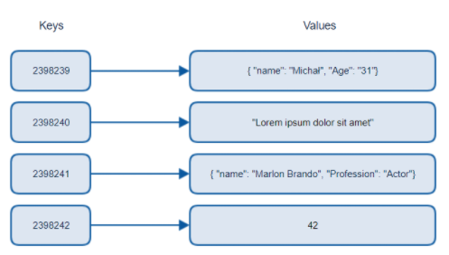
Key-Value Pair Databases
Key-value databases are modeled on a simple, two-part data structure consisting of an identifier and a data value.
The important principle to remember about keys is that they must be unique.

Slide 48
Key-Value Pair Databases
Values - are data stored along with keys.
Like luggage, values in a key-value database can store many different things.
Values can be as simple as a string, such as a name, or a number, such as the number of items in a customer’s shopping cart.
You can store more complex values, such as images or binary objects, too.
Key-value databases give developers a great deal of flexibility when storing values.
For example, strings can vary in length. Values can also vary in type. An employee database might include photos of employees using keys such as Emp328.photo.

Slide 49






Key-value store Representatives
MemcachedDB
not
open-source
open-source
version
Project Voldemort

Slide 50
Differences Between Key-Value and Relational Databases
Key-value databases are modeled on minimal principles for storing and retrieving data.
Unlike in relational databases, there are no tables, so there are no features associated with tables, such as columns and constraints on columns.
There is no need for joins in key-value databases, so there are no foreign keys.
Key-value databases do not support a rich query language such as SQL.
Some key-value databases support buckets, or collections, for creating separate namespaces within a database. This can be used to implement something analogous to a relational schema.

Slide 51
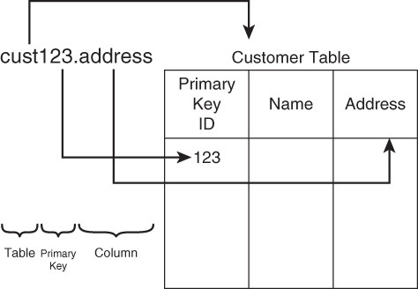
Differences Between Key-Value and Relational Databases

Slide 52
RIAK Database

Slide 53
What is RIAK?
Key Value store
Distributed and horizontal Scalable
Fault Tolerant
Highly available
Built for web
Based on Amazon Dynamo

Slide 54
What is RIAK?
Riak is a highly resilient NoSQL database.
It ensures your most critical data is always available and that your Big Data applications can scale.
Riak KV can be operationalized at lower costs than both relational and other NoSQL databases, especially at scale.
Running on commodity hardware ( inexpensive, widely available and basically interchangeable with other hardware of its type)
Riak KV stores data as a combination of keys and values, and is a fundamentally content-agnostic database.
You can use it to store anything you want – JSON, XML, HTML, documents, binaries, images, and more.
Keys are simply binary values used to uniquely identify a value.

Slide 55
KEY-VALUE STORE
Simple operations - GET, PUT, DELETE
Value is opaque (mostly), with metadata
Extras, e.g.
Secondary Indexes (2i)
MapReduce
Commit Hooks

Slide 56
HORIZONTALLY SCALABLE
Default configuration is optimized for a cluster
Query load and data are spread evenly
Add more nodes and get more:
operations/second
storage capacity
compute power (for Map/Reduce)

Slide 57
FAULT TOLERANT
All nodes participate equally - no single point of failure (SPOF)
All data is replicated
Cluster transparently survives...
node failure
network partitions

Slide 58
HIGHLY AVAILABLE
Any node can serve client requests
Fall backs are used when nodes are down
Always accepts read and write requests
Per-request quorums

Slide 59
CORE CONCEPTS in Riak
Node - An instance of Riak
Cluster – A collection of connected Riak nodes
Bucket - Logical grouping of objects. Shared configuration
Key - An identifier for a record/object
Value - Opaque binary representation of data stored with key
Metadata - Additional data linked to record, not part of value
Riak Object - Bucket, Key, Value and Metadata. Unit of replication.

Slide 60
CORE CONCEPTS in Riak
Partition - Logical division of storage
Vnode - Process handling requests and managing a partition
Ownership Handoff - Transfer of data on cluster change
Hinted Handoff - Transfer of data on node/network failure
Quorum - Set of nodes required to participate in transaction

Slide 61
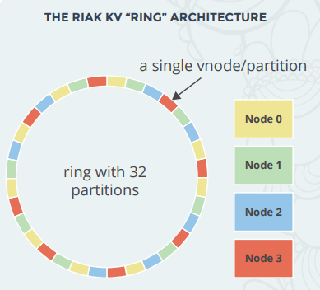
THE RIAK RING
The basis of Riak KV’s masterless architecture, replication, and fault tolerance is the Ring.
This Ring is a managed collection of partitions that share a common hash space.
The hash space is called a Ring because the last value in the hash space is thought of as being adjacent to the first value in the space.
Replicas of data are stored in the “next N partitions” of the hash spaces.

Slide 62
NODES AND VNODES
Each node in a Riak KV cluster manages one or many virtual nodes, or vnodes.
Each vnode is a separate process which is assigned a partition of the Ring, and is responsible for a number of operations in a Riak cluster, from the storing of objects, to handling of incoming read/write requests from other vnodes, to interpreting causal context metadata for objects.
If your cluster has 64 partitions and you are running three nodes, two of your nodes will have 21 vnodes, while the third node holds 22 vnodes.
The concept of vnodes is important as we look at data replication.
No single vnode is responsible for more than one replica of an object.
Each object belongs to a primary vnode, and is then replicated to neighboring vnodes located on separate nodes in the cluster.

Slide 63
CAP Theorem - AP
Riak KV is a tunable AP system.
By default, Riak KV replicas are “eventually consistent,” meaning that while data is always available, not all replicas may have the most recent update at the exact same time, causing brief periods—generally on the order of milliseconds—of inconsistency while all state changes are synchronized.
Riak KV is designed to deliver maximum data availability, so as long as your client can reach one Riak KV server, it can write data.

Slide 64
Document Databases
Document databases, also called document-oriented databases.
It uses a key-value approach to storing data but with important differences from key-value databases. A document database stores values as documents.
Documents are semi-structured entities, typically in a standard format such as JavaScript Object Notation (JSON) or Extensible Markup Language (XML).
when the term document is used in this context, it does not refer to word processing or other office productivity files. It refers to data structures that are stored as strings or binar representations of strings.

Slide 65
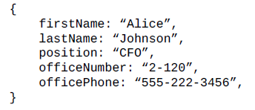
Document Databases
Documents
Instead of storing each attribute of an entity with a separate key, document databases store multiple attributes in a single document.
One of the most important characteristics of document databases is you do not have to define a fixed schema before you add data to the database.

Slide 66
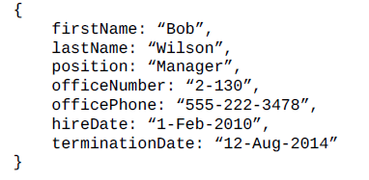
Document Databases
Simply adding a document to the database creates the underlying data structures needed to support the document.
The lack of a fixed schema gives developers more flexibility with document databases than they have with relational databases.
For example, employees can have different attributes than the ones listed above. Another valid employee document is

Slide 67
Document Databases
Querying Documents
Document databases provide application programming interfaces (APIs) or query languages that enable you to retrieve documents based on attribute values.
For example, if you have a database with a collection of employee documents called “employees,” you could use a statement such as the following to return the set of all employees with the position Manager:
db.employees.find( { position:“Manager” })

Slide 68
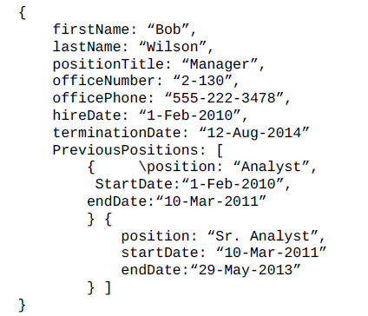
Differences Between Document and Relational Databases
A key distinction between document and relational databases is that document databases do not require a fixed, predefined schema.
Another important difference is that documents can have embedded documents and lists of multiple values within a document.

Slide 69
Differences Between Document and Relational Databases
Document databases are probably the most popular type of NoSQL database. They offer support for querying structures with multiple attributes, like relational databases, but offer more flexibility with regard to variation in the attributes used by each document.

Slide 70
Difference between RDBMS and MongoDB
RDBMS | MongoDB
It is a relational database. | It is a non-relational and document-oriented database.
Not suitable for hierarchical data storage. | Suitable for hierarchical data storage.
It is vertically scalable i.e increasing RAM. | It is horizontally scalable i.e we can add more servers.
It has a predefined schema. | It has a dynamic schema.
It is quite vulnerable to SQL injection. | It is not affected by SQL injection.
It centers around ACID properties (Atomicity, Consistency, Isolation, and Durability). | It centers around the CAP theorem (Consistency, Availability, and Partition tolerance).
It is row-based. | It is document-based.
It is slower in comparison with MongoDB. | It is almost 100 times faster than RDBMS.
Supports complex joins. | No support for complex joins.
It is column-based. | It is field-based.
It does not provide JavaScript client for querying. | It provides a JavaScript client for querying.
It supports SQL query language only. | It supports JSON query language along with SQL.

Slide 71
What is MongoDB?
Defination: MongoDB is an open source, document-oriented database designed with both scalability and developer agility in mind.
Instead of storing your data in tables and rows as you would with a relational database, in MongoDB you store JSON-like documents with dynamic schemas (schema-free, schemaless).

Slide 72
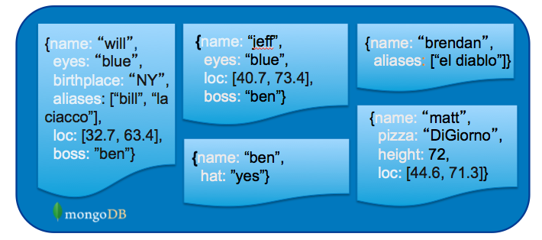
What is MongoDB? (Cont’d)
Document-Oriented DB
Unit object is a document instead of a row (tuple) in relational DBs

Slide 73
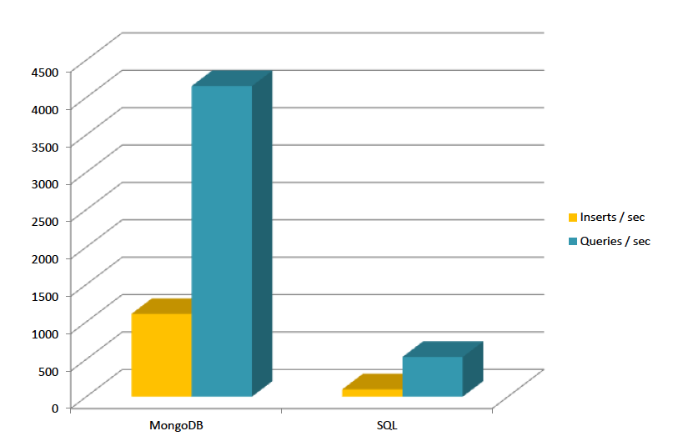
Is It Fast?
For semi-structured & complex relationships: Yes

Slide 74
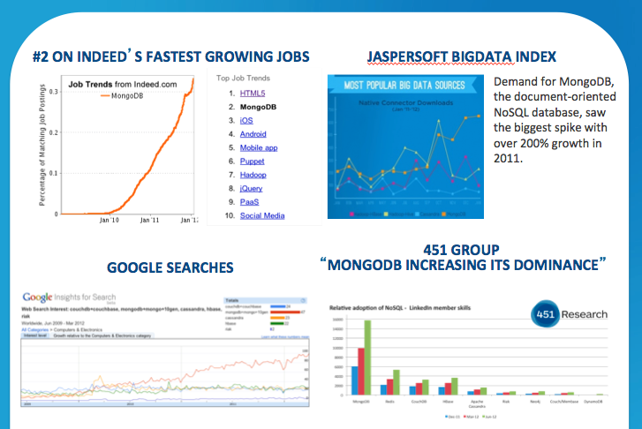
It is Growing Fast

Slide 75

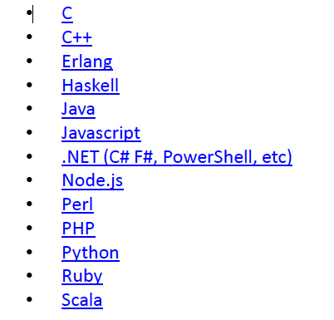
Integration with Others

Slide 76
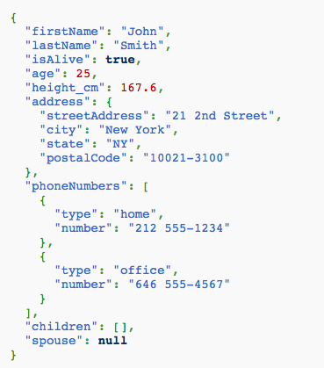
JSON
Field Name
Field Value
Scalar (Int, Boolean, String, Date, …)
Document (Embedding or Nesting)
Array of JSON objects
Field Value
One document

Slide 77
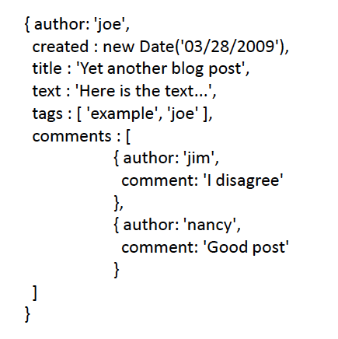
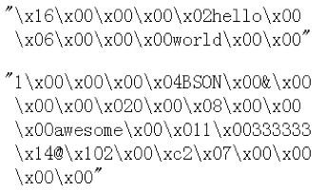
Another Example
Remember it is stored in binary formats (BSON)

Slide 78
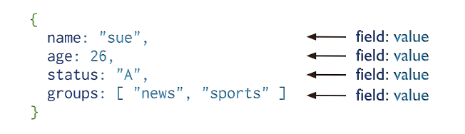
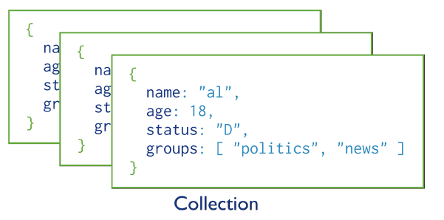
MongoDB Model
One document (e.g., one tuple in RDBMS)
Collection is a group of similar documents
Within a collection, each document must have a unique Id
One Collection (e.g., one Table in RDBMS)
Unlike RDBMS:
No Integrity Constraints in MongoDB

Slide 79
MongoDB Model
One document (e.g., one tuple in RDBMS)
The field names cannot start with the $ character
The field names cannot contain the . character
Max size of single document 16MB
One Collection (e.g., one Table in RDBMS)

Slide 80
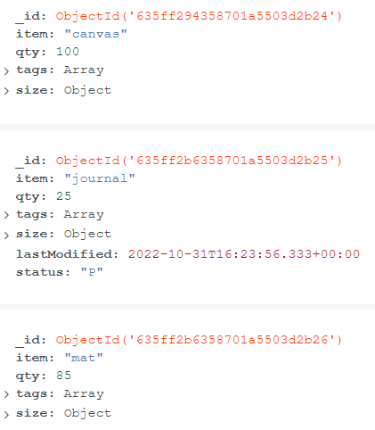
Example Document in MongoDB
_id is a special column in each document
Unique within each collection
_id ⬅➔ Primary Key in RDBMS
_id is 12 Bytes, you can set it yourself
Or:
1st 4 bytes ➔ timestamp
Next 3 bytes ➔ machine id
Next 2 bytes ➔ Process id
Last 3 bytes ➔ incremental values

Slide 81
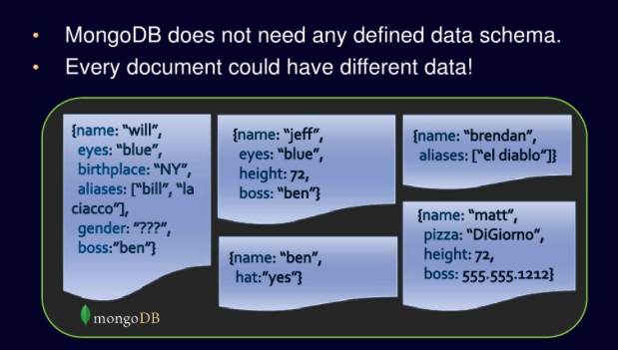
No Defined Schema (Schema-free Or Schema-less)

Slide 82
CRUD
Create
db.collection.insert( <document> )
db.collection.save( <document> )
db.collection.update( <query>, <update>, { upsert: true } )
Read
db.collection.find( <query>, <projection> )
db.collection.findOne( <query>, <projection> )
Update
db.collection.update( <query>, <update>, <options> )
Delete
db.collection.remove( <query>, <justOne> )

Slide 83
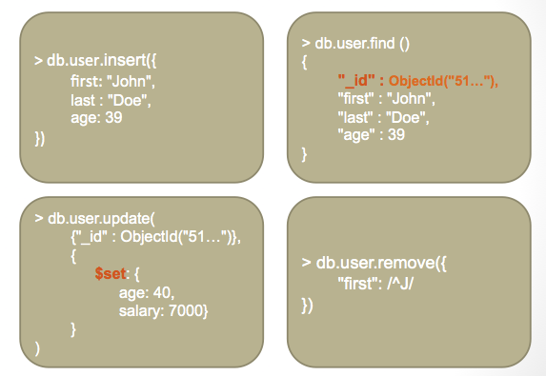
CRUD Examples

Slide 84
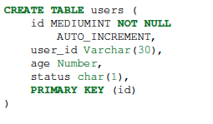
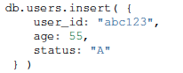

Examples
In RDBMS
In MongoDB
Either insert the 1st docuement
Or create “Users” collection explicitly

Slide 85
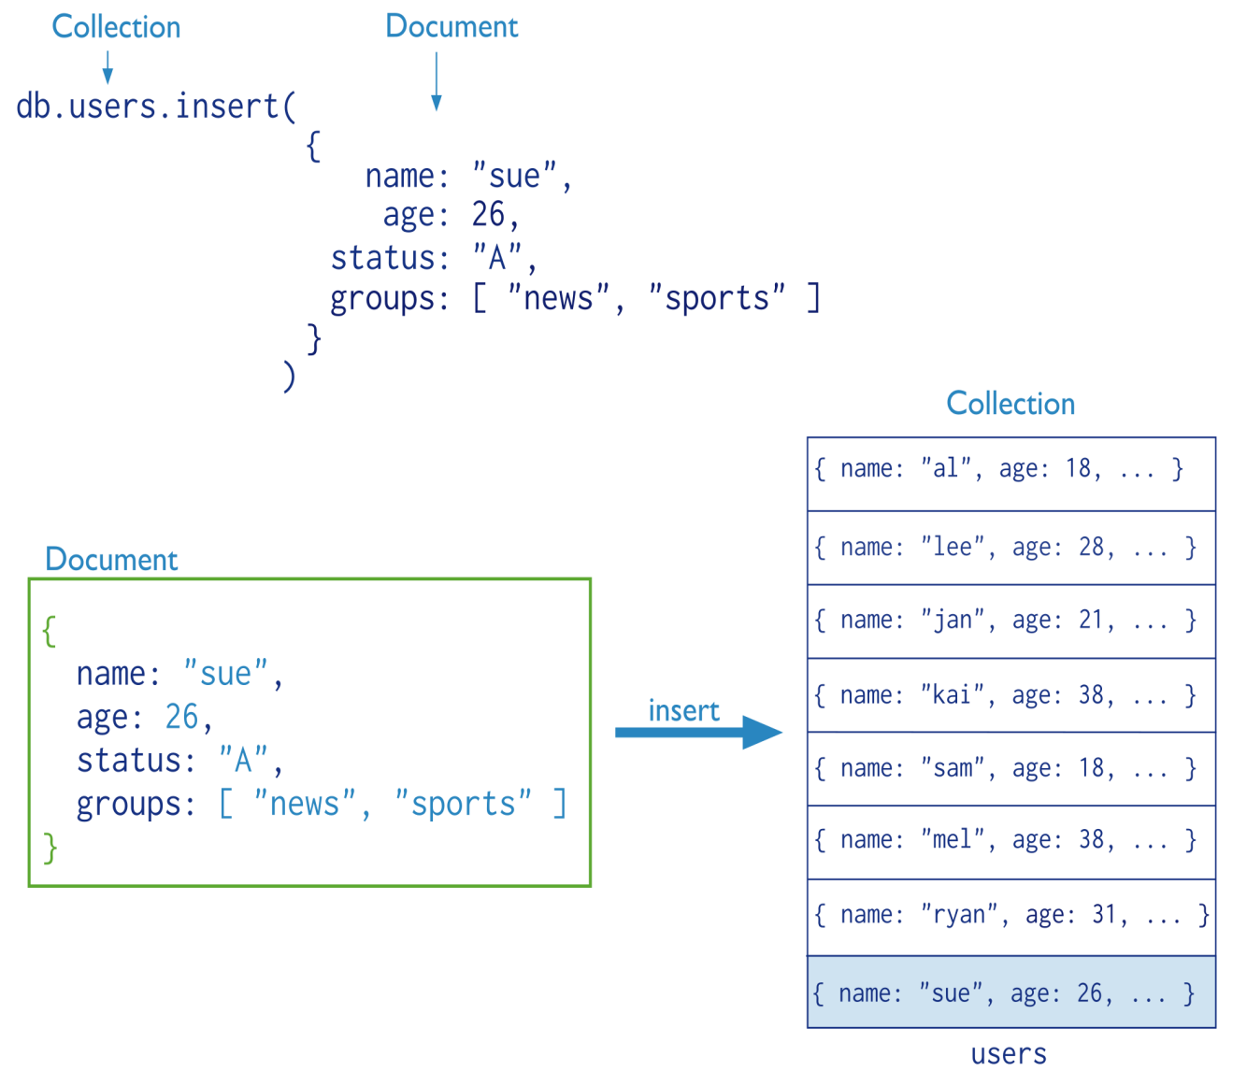
Insertion
The collection “users” is created automatically if it does not exist

Slide 86
Multi-Document Insertion (Use of Arrays)
All the documents are inserted at once

Slide 87
Multi-Document Insertion (Bulk Operation)
A temporary object in memory
Holds your insertions and uploads them at once
There is also Bulk Ordered object
_id column is added automatically

Slide 88
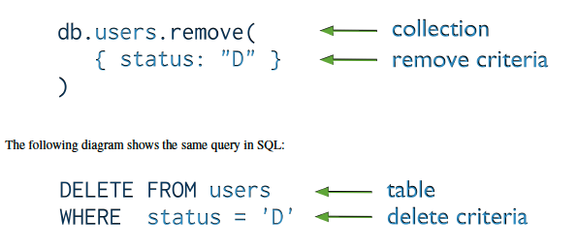
Deletion (Remove Operation)
You can put condition on any field in the document (even _id)
db.users.remove ( )
Removes all documents from users collection

Slide 89
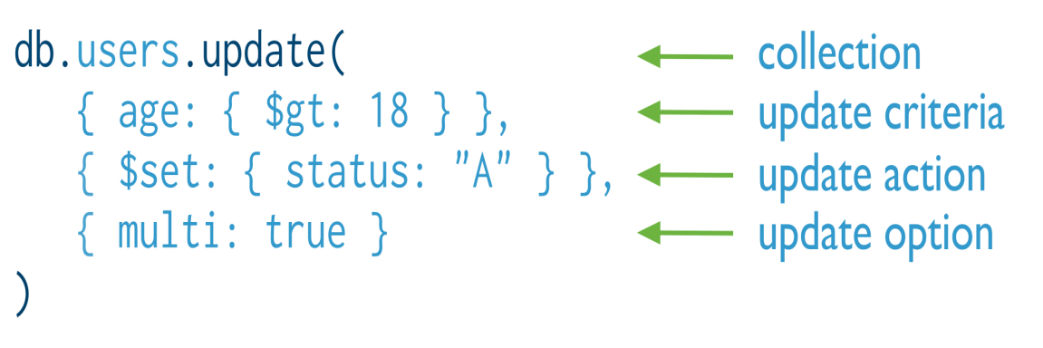
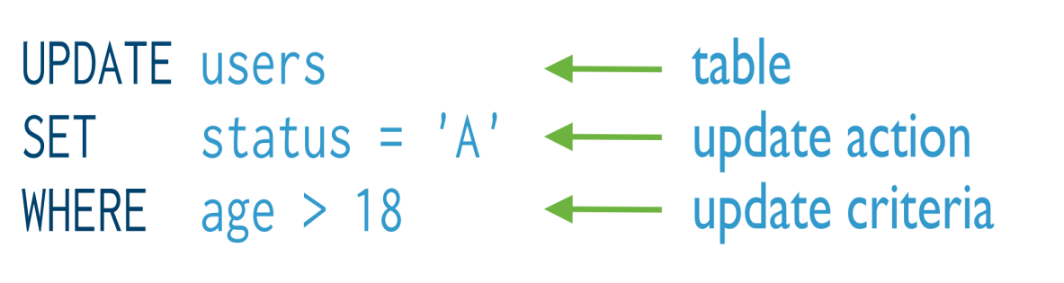
Update
Otherwise, it will update only the 1st matching document
Equivalent to in SQL:

Slide 90
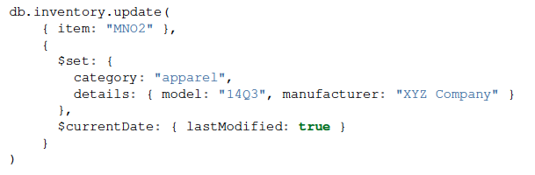
Update (Cont’d)
Two operators

Slide 91
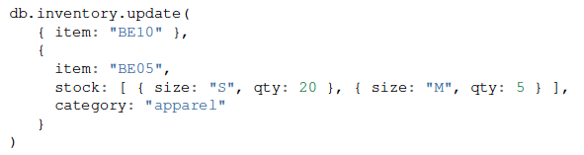
Replace a document
Query Condition
New
doc
For the document having item = “BE10”, replace it with the given document

Slide 92
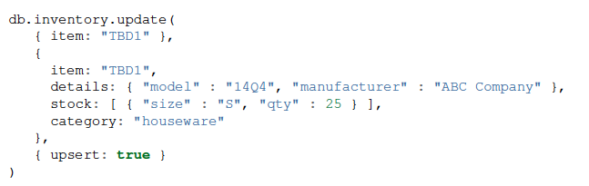
Insert or Replace
The upsert option
If the document having item = “TBD1” is in the DB, it will be replaced
Otherwise, it will be inserted.

Slide 93
Find queries
SELECT * FROM inventory
db.inventory.find{}
SELECT * FROM inventory WHERE status = "D"
db.inventory.find{ status: "D" }
SELECT * FROM inventory WHERE status in ("A", "D")
db.inventory.find{ status: { $in: [ "A", "D" ] } }
SELECT * FROM inventory WHERE status = "A" AND qty < 30
db.inventory.find{ status: "A", qty: { $lt: 30 } }
SELECT * FROM inventory WHERE status = "A" OR qty < 30
db.inventory.find{ $or: [ { status: "A" }, { qty: { $lt: 30 } } ] }
SELECT * FROM inventory WHERE status = "A" AND ( qty < 30 OR item LIKE "p%")
db.inventory.find{ status: "A", $or: [ { qty: { $lt: 30 } }, { item: /^p/ } ] }

Slide 94



Must Practice It
Install it
Practice simple stuff
Move to complex stuff
Install it from here: http://www.mongodb.org
Manual: http://docs.mongodb.org/master/MongoDB-manual.pdf
Dataset: http://docs.mongodb.org/manual/reference/bios-example-collection/
Online Execution: https://docs.mongodb.com/manual/tutorial/insert-documents/

Slide 95
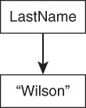
Column Family Databases
Column family databases are perhaps the most complex of the NoSQL database types, at least in terms of the basic building block structures.
Column family databases share some terms with relational databases, such as rows and columns.
Columns and Column Families
A column is a basic unit of storage in a column family database. A column is a name and a value.

Slide 96
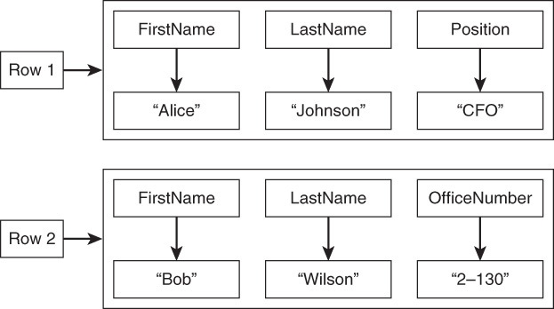
Column Family Databases
A set of columns makes up a row. Rows can have the same columns, or they can have different columns, as shown in Fig

Slide 97
Column Family Databases
When there are large numbers of columns, it can help to group them into collections of related columns.
For example, first and last name are often used together, and office numbers and office phone numbers are frequently needed together.
These can be grouped in collections called column families.
Column family databases do not require a predefined fixed schema.
Developers can add columns as needed. Also, rows can have different sets of columns and super columns.
Column family databases are designed for rows with many columns.

Slide 98
Column Family Databases
Column-oriented databases work on columns and are based on BigTable paper by Google.
Every column is treated separately.
Values of single column databases are stored contiguously.
They deliver high performance on aggregation queries like SUM, COUNT, AVG, MIN etc. as the data is readily available in a column.
Column-based NoSQL databases are widely used to manage data warehouses, business intelligence, CRM, Library card catalogs,
HBase, Cassandra, Hypertable are NoSQL query examples of column based database.
Cassandra is more fast and scalable as compared to other column-family databases with write operations because data is spread across the cluster.

Slide 99
Differences Between Column Family and Relational Databases
Column family databases and relational databases are superficially similar. They both make use of rows and columns.
There are important differences in terms of data models and implementation details.
One thing missing from column family databases is support for joining tables.
Tables in relational databases have a relatively fixed structure, and the relational database management system can take advantage of that structure when optimizing the layout.
Unlike a relational database table, the set of columns in a column family table can vary from one row to another.
In relational databases, data about an object can be stored in multiple tables. Column family databases are typically denormalized, or structured so that all relevant information about an object is in a single, possibly very wide, row.

Slide 100
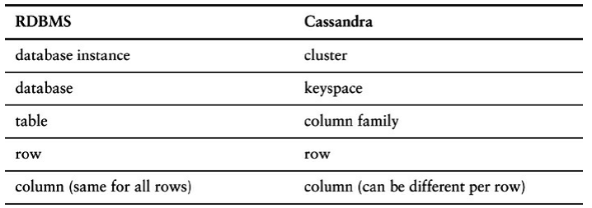
Column-Family Database - Cassandra

Slide 101
Cassandra
Apache Cassandra is a highly scalable, high-performance distributed database designed to handle large amounts of data across many commodity servers, providing high availability with no single point of failure.
It is a type of NoSQL database.
It is a column-oriented database.
Its distribution design is based on Amazon’s Dynamo and its data model on Google’s Bigtable.
Created at Facebook, it differs sharply from relational database management systems.
Cassandra is being used by some of the biggest companies such as Facebook, Twitter, Cisco, Rackspace, eBay, Netflix, and more.

Slide 102
Cassandra
Features of Cassandra :
Cassandra has become so popular because of its outstanding technical features. Given below are some of the features of Cassandra:
Elastic scalability − Cassandra is highly scalable; it allows to add more hardware to accommodate more customers and more data as per requirement.
Always on architecture − Cassandra has no single point of failure and it is continuously available for business-critical applications that cannot afford a failure.
Fast linear-scale performance − Cassandra is linearly scalable, i.e., it increases your throughput as you increase the number of nodes in the cluster. Therefore it maintains a quick response time.

Slide 103
Cassandra
Flexible data storage − Cassandra accommodates all possible data formats including: structured, semi-structured, and unstructured. It can dynamically accommodate changes to your data structures according to your need.
Easy data distribution − Cassandra provides the flexibility to distribute data where you need by replicating data across multiple data centers.
Transaction support − Cassandra supports properties like Atomicity, Consistency, Isolation, and Durability (ACID).
Fast writes − Cassandra was designed to run on cheap commodity hardware. It performs blazingly fast writes and can store hundreds of terabytes of data, without sacrificing the read efficiency.

Slide 104
Cassandra
History of Cassandra :
Cassandra was developed at Facebook for inbox search.
It was open-sourced by Facebook in July 2008.
Cassandra was accepted into Apache Incubator in March 2009.
It was made an Apache top-level project since February 2010.

Slide 105
Cassandra - Architecture
The design goal of Cassandra is to handle big data workloads across multiple nodes without any single point of failure.
Cassandra has peer-to-peer distributed system across its nodes, and data is distributed among all the nodes in a cluster.
All the nodes in a cluster play the same role. Each node is independent and at the same time interconnected to other nodes.
Each node in a cluster can accept read and write requests, regardless of where the data is actually located in the cluster.
When a node goes down, read/write requests can be served from other nodes in the network.

Slide 106
Cassandra - Architecture
Components of Cassandra :
Basic Terminology:
Node
Data center
Cluster
Operations:
Read Operation
Write Operation
Storage Engine:
CommitLog
Memtables
SSTables
Data Replication Strategies
Simple Replication Strategy
Network Topology Strategy

Slide 107
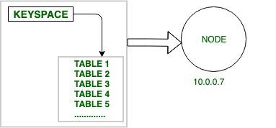
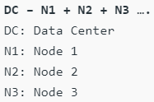
Cassandra - Architecture
Basic Terminology:−
Node − Node is the basic component in Apache Cassandra. It is the place where actually data is stored. For Example: As shown in diagram node which has IP address 10.0.0.7 contain data (keyspace which contain one or more tables)..
Data center − It is a collection of related nodes.

Slide 108
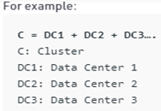
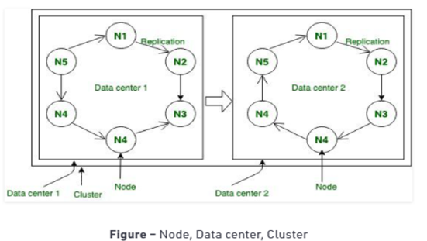
Cassandra - Architecture
Cluster − A cluster is a component that contains one or more data centers.

Slide 109
Cassandra - Architecture
Operations:
Read Operation: In Read Operation there are three types of read requests that a coordinator can send to a replica. The node that accepts the write requests called coordinator for that particular operation.
Step-1: Direct Request: In this operation coordinator node sends the read request to one of the replicas.
Step-2: Digest Request: In this operation coordinator will contact to replicas specified by the consistency level. For Example: CONSITENCY TWO; It simply means that Any two nodes in data center will acknowledge.
Step-3: Read Repair Request: If there is any case in which data is not consistent across the node then background Read Repair Request initiated that makes sure that the most recent data is available across the nodes.

Slide 110
Cassandra - Architecture
Write Operation:
Step-1: In Write Operation as soon as we receives request then it is first dumped into commit log to make sure that data is saved.
Step-2: Insertion of data into table that is also written in MemTable that holds the data till it’s get full.
Step-3: If MemTable reaches its threshold then data is flushed to SS Table.

Slide 111
Cassandra - Architecture
Storage Engine:
Commit log − The commit log is a crash-recovery mechanism in Cassandra. Every write operation is written to the commit log.
Mem-table − A mem-table is a memory-resident data structure. After commit log, the data will be written to the mem-table. Sometimes, for a single-column family, there will be multiple mem-tables.
SSTable − It is a disk file to which the data is flushed from the mem-table when its contents reach a threshold value.
Bloom filter: These are nothing but quick, nondeterministic, algorithms for testing whether an element is a member of a set. It is a special kind of cache. Bloom filters are accessed after every query.

Slide 112
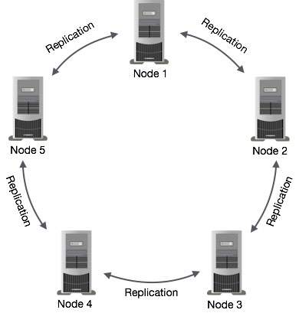
Cassandra - Architecture
Data Replication in Cassandra:
In Cassandra, one or more of the nodes in a
cluster act as replicas for a given piece of data.
If it is detected that some of the nodes responded
with an out-of-date value, Cassandra will return
the most recent value to the client.
After returning the most recent value,
Cassandra performs a read repair
in the background to update the stale values.
The following figure shows a schematic view of how Cassandra uses data replication among the nodes in a cluster to ensure no single point of failure.
Note − Cassandra uses the Gossip Protocol in the background to allow the nodes to communicate with each other and detect any faulty nodes in the cluster.

Slide 113
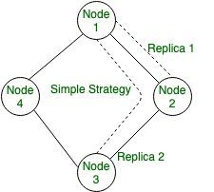
Cassandra - Architecture
Data Replication Strategy:
Basically it is used for backup to ensure no single point of failure.
In this strategy Cassandra uses replication to achieve high availability and durability.
Each data item is replicated at N hosts, where N is the replication factor configured \per-instance.
There are two type of replication Strategy: Simple Strategy, and Network Topology Strategy.
Simple Strategy:
In this Strategy it allows a single integer RF
(replication_ factor) to be defined.
It determines the number of nodes that should contain
a copy of each row. For example, if replication_ factor
is 2, then two different nodes should store a copy of
each row.
It treats all nodes identically.

Slide 114
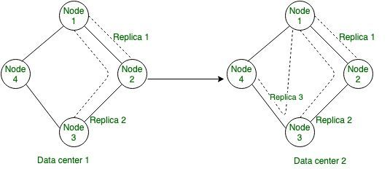
Cassandra - Architecture
2. Network Topology Strategy:
In this strategy it allows a replication factor to be specified for each datacenter in the cluster. Even if your cluster only uses a single datacenter.
This Strategy should be preferred over Simple Strategy to make it easier to add new physical or virtual data centers to the cluster later.

Slide 115
Application of Apache Cassandra
Real-time, big data workloads
Time series data management
High-velocity device data consumption and analysis
Media streaming management (e.g., music, movies)
Social media (i.e., unstructured data) input and analysis
Online web retail (e.g., shopping carts, user transactions)
Real-time data analytics
Online gaming (e.g., real-time messaging)
Software as a Service (SaaS) applications that utilize web services
Online portals (e.g., healthcare provider/patient interactions)
Most write-intensive systems

Slide 116

Cassandra Query Language (CQL)
CQL provides a rich set of built-in data types, including collection types. Along with these data types, users can also create their own custom data types. The following table provides a list of built-in data types available in CQL.

Slide 117

Cassandra Query Language (CQL)
Collection Types : Cassandra Query Language also provides a collection data types. The following table provides a list of Collections available in CQL.
User-defined data types : Cqlsh provides users a facility of creating their own data types. Given below are the commands used while dealing with user defined datatypes.
CREATE TYPE − Creates a user-defined datatype.
ALTER TYPE − Modifies a user-defined datatype.
DROP TYPE − Drops a user-defined datatype.
DESCRIBE TYPE − Describes a user-defined datatype.
DESCRIBE TYPES − Describes user-defined datatypes.

Slide 118
Cassandra Query Language (CQL)
CQL query for Basic Operation: Step1: To create keyspace used the following CQL query.
CREATE KEYSPACE Emp
WITH replication = {'class': 'SimpleStrategy','replication_factor': '1'};
Step2: CQL query for using keyspace
Syntax: USE keyspace-name
USE Emp;
Step-3: To create table used the following CQL query.
Example: CREATE TABLE Emp_table (
name text PRIMARY KEY,
Emp_id int,
Emp_city text,
Emp_email text );

Slide 119
Cassandra Query Language (CQL)
Step-4: To insert into Emp_table used the following CQL query.
Insert into Emp_table(name, Emp_id, Emp_city, Emp_email)
VALUES ('ashish', 1001, 'Delhi', 'ashish05.rana05@gmail.com');
Insert into Emp_table(name, Emp_id, Emp_city, Emp_email)
VALUES ('Ashish Gupta', 1001, 'Bangalore', 'ashish@gmail.com');
Insert into Emp_table(name, Emp_id, Emp_city, Emp_email)
VALUES ('amit ', 1002, 'noida', 'abc@gmail.com');
Insert into Emp_table(name, Emp_id, Emp_city, Emp_email)
VALUES ('dhruv', 1003, 'pune', 'xyz@gmail.com');
Insert into Emp_table(name, Emp_id, Emp_city, Emp_email)
VALUES ('shivang', 1004, 'mumbai', 'test@gmail.com');
Insert into Emp_table(name, Emp_id, Emp_city, Emp_email)
VALUES ('aayush', 1005, 'gurugram', 'cass_write@gmail.com');
Step-5: To read data used the following CQL query.
SELECT * FROM Emp_table;

Slide 120
Cassandra Keyspace Operations
Create Keyspace:
CREATE KEYSPACE “KeySpace Name” WITH replication = {'class': Strategy name’, 'replication_factor‘: ‘No.Of replicas’};
Ex: CREATE KEYSPACE emp WITH replication =
{'class':'SimpleStrategy', 'replication_factor' : 1};
The replication option specifies the replica placement strategy and the number of replicas wanted.
You can verify whether the table is created or not using the command Describe.
DESCRIBE keyspaces;
If you use this command over keyspaces, it will display all the keyspaces created
Using a Keyspace:
You can use a created KeySpace using the keyword USE.
Ex: USE emp;

Slide 121
Cassandra Keyspace Operations
Altering a KeySpace :
ALTER KEYSPACE can be used to alter properties such as the number of replicas and the
durable_writes of a KeySpace. Given below is the syntax of this command.
ALTER KEYSPACE “KeySpace Name” WITH replication = {'class':
‘Strategy name’, 'replication_factor' : ‘No.Of replicas’};
Ex: ALTER KEYSPACE emp WITH replication =
{'class':'Network Topology Strategy', 'replication_factor' : 3};
Dropping a Keyspace
You can drop a KeySpace using the command DROP KEYSPACE.
Given below is the syntax for dropping a KeySpace.
DROP KEYSPACE “KeySpace name”
Ex: DROP KEYSPACE emp;

Slide 122
Cassandra Table Operations
Creating a Table: You can create a table using the command CREATE TABLE
CREATE TABLE tablename(
column1 name datatype PRIMARYKEY,
column2 name data type,
column3 name data type. ) OR
CREATE TABLE tablename( column1 name datatype,
column2 name data type,
column3 name data type,
PRIMARY KEY (column1) )
The primary key is a column that is used to uniquely identify a row. Therefore, defining a primary key is mandatory while creating a table. A primary key is made of one or more columns of a table.
USE emp;
cqlsh:emp>; CREATE TABLE emp_table( emp_id int PRIMARY KEY,
emp_name text,
emp_city text,
emp_sal varint,
emp_phone varint );
The select statement will give you the schema.
cqlsh:emp> select * from emp_table;

Slide 123
Cassandra Table Operations
Altering a Table : You can alter a table using the command ALTER TABLE.
Using ALTER command, you can perform the following operations −
Add a column
Drop a column
While adding columns, you have to take care that the column name is not conflicting with the
existing column names.
ALTER TABLE table name ADD new column datatype;
Ex: ALTER TABLE emp_table ADD emp_email text;
Dropping a Column: Using ALTER command, you can delete a column from a table.
ALTER table name DROP column name;
Ex: ALTER TABLE emp_table DROP emp_email;

Slide 124
Cassandra Table Operations
Dropping a Table: You can drop a table using the command Drop Table. Its syntax is as follows −
DROP TABLE <tablename>
Ex: DROP TABLE emp_table;
Creating an Index: You can create an index in Cassandra using the command CREATE INDEX
CREATE INDEX name ON emp1 (emp_name);
Dropping an Index: You can drop an index using the command DROP INDEX
drop index name;

Slide 125
Cassandra CRUD Operations
Creating Data in a Table : You can insert data into the columns of a row in a table using the command INSERT
INSERT INTO <tablename> (<column1 name>, <column2 name>....) VALUES (<value1>, <value2>....) USING <option>
cqlsh:emp> INSERT INTO emp_table (emp_id, emp_name, emp_city, emp_phone, emp_sal) VALUES(1,'ram', 'Hyderabad', 9848022338, 50000);
cqlsh:emp> INSERT INTO emp_table (emp_id, emp_name, emp_city, emp_phone, emp_sal) VALUES(2,'robin', 'Hyderabad', 9848022339, 40000);

Slide 126
Cassandra CRUD Operations
UPDATE is the command used to update data in a table. The following keywords are used while updating data in a table −
Where − This clause is used to select the row to be updated.
Set − Set the value using this keyword.
Must − Includes all the columns composing the primary key.
While updating rows, if a given row is unavailable, then UPDATE creates a fresh row.
UPDATE <tablename> SET <column name> = <new value> <column name> = <value>.... WHERE <condition>
cqlsh:emp> UPDATE emp_table SET emp_city='Delhi',emp_sal=50000 WHERE
emp_id=2;

Slide 127
Cassandra CRUD Operations
Reading Data using Select Clause: SELECT clause is used to read data from a table in Cassandra. Using this clause, you can read a whole table, a single column, or a particular cell.
SELECT FROM <tablename>
Ex: cqlsh:emp> select * from emp_table;
Ex: cqlsh:emp> SELECT emp_name, emp_sal from emp_table;
Where Clause: Using WHERE clause, you can put a constraint on the required columns.
SELECT FROM <table name> WHERE <condition>;
Ex: cqlsh:emp> SELECT * FROM emp_table WHERE emp_sal=50000;

Slide 128


Cassandra CURD Operations
Deleting Data from a Table: You can delete data from a table using the command DELETE.
DELETE FROM <identifier> WHERE <condition>;
Ex: DELETE emp_sal FROM emp_table WHERE emp_id=3;

Slide 129

Cassandra CRUD Operations
Deleting an Entire Row: The following command deletes an entire row from a table.
Ex: cqlsh:emp> DELETE FROM emp_table WHERE emp_id=3;

Slide 130
Cassandra vs RDBMS
Cassandra | RDBMS
Cassandra is used to deal with unstructured data. | RDBMS is used to deal with structured data.
Cassandra has flexible schema. | RDBMS has fixed schema.
In Cassandra, a table is a list of "nested key-value pairs". (Row x Column Key x Column value) | In RDBMS, a table is an array of arrays. (Row x Column)
In Cassandra, keyspace is the outermost container which contains data corresponding to an application. | In RDBMS, database is the outermost container which contains data corresponding to an application.
In Cassandra, tables or column families are the entity of a keyspace. | In RDBMS, tables are the entities of a database.
In Cassandra, row is a unit of replication. | In RDBMS, row is an individual record.
In Cassandra, column is a unit of storage. | In RDBMS, column represents the attributes of a relation.
In Cassandra, relationships are represented using collections. | In RDBMS, there are concept of foreign keys, joins etc.

Slide 131
Cassandra
https://cassandra.apache.org/_/index.html
How to Install Cassandra on Windows 10
Get Started with Apache Cassendra
OR
Cassandra using Astra Datastax

Slide 132
Graph Databases
Graph databases are the most specialized of the four NoSQL databases.
Instead of modeling data using columns and rows, a graph database uses structures called nodes and relationships.
A relationship is a link between two nodes that contain attributes about that relation.
Nodes and Relationships
There are many ways to use graph databases. Nodes can represent people, and relationships can represent their friendships in social networks.

Slide 133

Graph Databases
Attributes include flying times between cities

Slide 134

Graph Databases
Both the nodes and relationships can have complex structures.
For example, each city can have a list of airports along with demographic and geographic data about the city, as shown in Fig.

Slide 135
Differences Between Graph and Relational Databases
Graph databases are designed to model adjacency between objects. Every node in the database contains pointers to adjacent objects in the database. This allows for fast operations that require paths through a graph.
Performing this same kind of analysis in a relational database would be more involved. Querying is more difficult. You would have to write multiple SQL statements or use specialized recursive statements if they are provided.
Graph databases allow for more efficient querying when paths through graphs are involved.

Slide 136
Graph Database vs. RDBMS
Graph Database | RDBMS
In graph database, data is stored in graphs. | In RDBMS, data is stored in tables.
In graph database there are nodes. | In RDBMS, there are rows.
In graph database there are properties and their values. | In RDBMS, there are columns and data.
In graph database the connected nodes are defined by relationships. | In RDBMS, constraints are used instead of that.
In graph database traversal is used instead of join. | In RDBMS, join is used instead of traversal.

Slide 137

Graph Database
In the example graph in Figure, we see a bunch of nodes related to each other. Nodes are entities that have properties, such as name.
The node of Martin is actually a node that has property of name set to Martin.

Slide 138
Graph Database
We also see that edges have types, such as likes, author, and so on.
These properties let us organize the nodes; for example, the nodes Martin and Pramod have an edge connecting them with a relationship type of friend.
Relationship types have directional significance; the friend relationship type is bidirectional but likes is not. When Dawn likes NoSQL Distilled, it does not automatically mean NoSQL Distilled likes Dawn.
Once we have a graph of these nodes and edges created, we can query the graph in many ways, eg: “get all nodes employed by Big Co that like NoSQL Distilled.”
A query on the graph is also known as traversing the graph. An advantage of the graph databases is that we can change the traversing requirements without having to change the nodes or edges.

Slide 139
Advantages of Graph Database
PERFORMANCE -
For intensive data relationship handling, graph databases improve performance by several orders of magnitude.
With traditional databases, relationship queries will come to a grinding halt as the number and depth of relationships increase. In contrast, graph database performance stays constant even as your data grows year over year.
FLEXIBILITY
With graph databases, IT and data architect teams move at the speed of business because the structure and schema of a graph model flexes as applications and industries change.
Rather than exhaustively modeling a domain ahead of time, data teams can add to the existing graph structure without compromising current functionality.

Slide 140
Advantages of Graph Database
AGILITY
Developing with graph databases aligns perfectly with today’s agile, test-driven development practices, allowing your graph database to evolve in step with the rest of the application and any changing business requirements.
Modern graph databases are equipped for frictionless development and graceful systems maintenance.

Slide 141
Application of Graph Database
Graph databases are therefore highly beneficial to specific use cases:
Fraud Detection
360 Customer Views
Recommendation Engines
Network/Operations Mapping
AI Knowledge Graphs
Social Networks
Supply Chain Mapping

Slide 142
Limitations of Graph Database
Lack of high performance concurrency. In many cases, GDBs provide multiple reader and single writer type of transactions, which hampers their concurrency and performance as a consequence, somewhat limiting the threaded parallelism.
Lack of standard languages. The lack of a well established and standard declarative language is being a problem nowadays. Neo4j is proposing Cypher and Oracle is working on a language. This is implicitly a problem because optimisation is an important issue, and having standard languages facilitates the evolution of this necessary technologies.
Lack of parallelism. One important issue is the fact that partitioning a graph is a problem. Thus, most GDBs do not provide shared nothing parallel queries on very large graphs. Thus, allowing for parallelism is intrinsically a problem.

Slide 143
Features of Graph Database
There are many graph databases available, such as Neo4J [Neo4J], Infinite Graph [Infinite Graph], OrientB [OrientDB], or FlockDB [FlockDB].
In Neo4J, creating a graph is as simple as creating two nodes and then creating a relationship. Let’s create two nodes, Martin and Pramod:
Node martin = graphDb.createNode();
martin.setProperty("name", "Martin");
Node pramod = graphDb.createNode();
pramod.setProperty("name", "Pramod");
We have assigned the name property of the two nodes the values of Martin and Pramod. Once we have more than one node, we can create a relationship:
martin.createRelationshipTo(pramod,FRIEND); pramod.createRelationshipTo(martin, FRIEND);

Slide 144

Features of Graph Database
We have to create relationship between the nodes in both directions, for the direction of the relationship matters: For example, a product node can be liked by user but the product cannot like the user.
This directionality helps in designing a rich domain model (Figure).
Nodes know about
INCOMING and
OUTGOING
relationships that
are traversable both
ways.

Slide 145
Features of Graph Database
Relationships are first-class citizens in graph databases; most of the value of graph databases is derived from the relationships.
Relationships don’t only have a type, a start node, and an end node, but can have properties of their own.
Using these properties on the relationships, we can add intelligence to the relationship—for example, since when did they become friends, what is the distance between the nodes, or what aspects are shared between the nodes.
These properties on the relationships can be used to query the graph.
Adding new relationship types is easy; changing existing nodes and their relationships is similar to data migration, because these changes will have to be done on each node and each relationship in the existing data.

Slide 146
Neo4j Graph Database
Neo4j is a NoSQL database.
It is highly scalable and schema-free.
It's world most popular graph database management system and Cypher Query Language (CQL).
Neo4j is written in Java Language.
Neo4j was developed by Neo technology and called an ACID-compliant transactional database with native graph storage and processing.

Slide 147
Features of Neo4j
Flexible Schema: Neo4j follows a data model called graph model. The graph contains nodes and the nodes are connected to each other. Nodes and relationships store data in key-value pairs known as properties.
ACID Property: Neo4j supports full ACID properties (Atomicity, Consistency, Isolation and Durability).
Scalability: Neo4j facilitates you to scale the database by increasing the number of reads/writes, and the volume without affecting the data integrity and the speed of query processing.
Reliability: Neo4j provides replication for data safety and reliability.
Cypher Query Language: Neo4j provides a powerful declarative query language called Cypher Query language. It is used to create and retrieve relations between data without using the complex queries like Joins.
Built-in Web applications: Neo4j also provides a built-in Neo4j browser web application which can be used to create and retrieve your graph data.
GraphDB: Neo4j follows Property Graph Data Model.

Slide 148
General Features of Neo4j
It supports UNIQUE constraints.
It uses Native graph storage with Native GPE(Graph Processing Engine).
It supports exporting of query data to JSON and XLS format.
It provides REST API to be accessed by any Programming Language like Java, Spring, Scala etc.
It provides Java Script to be accessed by any UI MVC Framework like Node JS.
It supports two kinds of Java API: Cypher API and Native Java API to develop Java applications.

Slide 149
Advantages of Neo4j
Highly scalable: Neo4j is highly scalable. It provides a simple, powerful and flexible data model which can be changed according to applications and uses. It provides:
Higher vertical scaling.
Improved operational characteristics at scale.
Higher concurrency.
Simplified tuning.
Schema-free: Neo4j is schema-free like other NoSQL databases.
High availability: Neo4j provides high availability for large enterprise real-time applications with transactional guarantees.
Real-time data analysis: Neo4j provides results based on real-time data.

Slide 150
Advantages of Neo4j
Easy representation: Neo4j provides a very easy way to represent connected and semi-structured data.
Fast Execution: Neo4j is fast because more connected data is very easy to retrieve and navigate.
Easy retrieval: Neo4j facilitates you not only represent but also easily retrieve (traverse/navigate) connected data faster other databases comparatively.
Cypher Query language: Neo4j provides CQL (Cypher Query Language) a declarative query language to represent the graph visually, using ASCII-art syntax. The commands of this language is very easy to learn and human readable.
No Join: Neo4j doesn't require complex Joins to retrieve connected/related data as it is very easy to retrieve its adjacent node or relationship details without Joins or Indexes because it is a graph database and all nodes are already connected.

Slide 151
Neo4j CQL Functions
Index | Function | Usage
1. | STRING | They are used to work with string literals.
2. | Aggregation | They are used to perform some aggregation operations on CQL query results.
3. | Relationship | They are used to get details of relationships such as startnode, endnode, etc.

Slide 152
Neo4j CQL Data Types
Index | CQL Data Type | Usage
1. | Boolean | It is used to represent Boolean literals: True, False.
2. | byte | It is used to represent 8-bit integers.
3. | short | It is used to represent 16-bit integers.
4. | int | It is used to represent 32-bit integers.
5. | long | It is used to represent 64-bit integers.
6. | float | Float is used to represent 32-bit floating-point numbers.
7. | double | Double is used to represent 64-bit floating-point numbers.
8. | char | Char is used to represent 16-bit characters.
9. | String | String is used to represent strings.

Slide 153
Neo4j CQL Operators
Mathematical Operators: i.e. +, -, *, /, %, ^
Comparison Operators: i.e. =, <>, <, >, <=, >=
Boolean Operators: i.e. AND, OR, XOR, NOT
String Operators: i.e. =∼
List Operators: i.e. +, IN, [X], [X?..Y]
Regular Expression: i.e. =-
String matching: i.e. STARTS WITH, ENDS WITH, CONSTRAINTS

Slide 154
Neo4j - Building Blocks
Neo4j Graph Database has the following building blocks −
Nodes
Properties
Relationships
Labels
Data Browser

Slide 155

Neo4j - Building Blocks
Node:
Node is a fundamental unit of a Graph. It contains properties with key-value pairs as shown in the following image.
Here, Node Name = "Employee" and it contains a set of properties as key-value pairs.

Slide 156

Neo4j - Building Blocks
Properties:
Property is a key-value pair to describe Graph Nodes and Relationships.
Key = value
Where Key is a String and Value may be represented using any Neo4j Data types.
Relationships:
Relationships are another major building block of a Graph Database. It connects two nodes as depicted in the following figure.
Here, Emp and Dept are two different nodes. "WORKS_FOR" is a relationship between Emp and Dept nodes.

Slide 157

Neo4j - Building Blocks
Relationships:
As it denotes, the arrow mark from Emp to Dept, this relationship describes −
Each relationship contains one start node and one end node.
Here, "Emp" is a start node, and "Dept" is an end node.
As this relationship arrow mark represents a relationship from "Emp" node to "Dept" node, this relationship is known as an "Incoming Relationship" to "Dept" Node and "Outgoing Relationship" to "Emp" node.
Like nodes, relationships also can contain properties as key-value pairs.
Here, "WORKS_FOR" relationship has one property as key-value pair.
It represents an Id of this relationship.
Emp WORKS_FOR Dept
Id = 123

Slide 158
Neo4j - Building Blocks
Labels:
Label associates a common name to a set of nodes or relationships.
A node or relationship can contain one or more labels. We can create new labels to existing nodes or relationships. We can remove the existing labels from the existing nodes or relationships.
From the previous diagram, we can observe that there are two nodes.
Left side node has a Label: "Emp" and the right side node has a Label: "Dept".
Relationship between those two nodes also has a Label: "WORKS_FOR".

Slide 159
Neo4j - Building Blocks
Neo4j Data Browser:
Once we install Neo4j, we can access Neo4j Data Browser using the following URL
Neo4j Data Browser is used to execute CQL commands and view the output.
Here, we need to execute all CQL commands at dollar prompt: "$"
Type commands after the dollar symbol and click the "Execute" button to run your commands.
It interacts with Neo4j Database Server, retrieves and displays the results just below the dollar prompt.
Installation - Operations Manual (neo4j.com)
http://localhost:7474/browser/

Slide 160
Neo4j CQL - Introduction
CQL stands for Cypher Query Language. Like Oracle Database has query language SQL, Neo4j has CQL as query language.
Neo4j CQL
Is a query language for Neo4j Graph Database.
Is a declarative pattern-matching language.
Follows SQL like syntax.
Syntax is very simple and in human readable format.
Like Oracle SQL
Neo4j CQL has commands to perform Database operations.
Neo4j CQL supports many clauses such as WHERE, ORDER BY, etc., to write very complex queries in an easy manner.
Neo4j CQL supports some functions such as String, Aggregation. In addition to them, it also supports some Relationship Functions.

Slide 161
Neo4j CQL - Creating Nodes
A node is a data/record in a graph database. You can create a node in Neo4j using the CREATE clause.
Create a single node
Create multiple nodes
Create a node with a label
Create a node with multiple labels
Create a node with properties
Returning the created node
Creating a Single node:
You can create a node in Neo4j by simply specifying the name of the node that is to be created along with the CREATE clause.
CREATE (node_name);
CREATE (sample)

Slide 162
Neo4j CQL - Creating Nodes
Creating Multiple Nodes:
The create clause of Neo4j CQL is also used to create multiple nodes at the same time. To do so, you need to pass the names of the nodes to be created, separated by a comma.
Creating a Node with a Label:
A label in Neo4j is used to group (classify) the nodes using labels. You can create a label for a node in Neo4j using the CREATE clause.
CREATE (node1),(node2)
CREATE (sample1),(sample2)
CREATE (node:label)
CREATE (Dhawan:player)

Slide 163
Neo4j CQL - Creating Nodes
Creating a Node with Multiple Labels
You can also create multiple labels for a single node. You need to specify the labels for the node by separating them with a colon “ : ”.
Create Node with Properties
Properties are the key-value pairs using which a node stores data. You can create a node with properties using the CREATE clause. You need to specify these properties separated by commas within the flower braces “{ }”.
CREATE (node:label1:label2:. . . . labeln)
CREATE (Dhawan:person:player)
CREATE (node:label { key1: value, key2: value, . . . . . . . . . })
CREATE (Dhawan:player{name: "Shikar Dhawan", YOB: 1985, POB: "Delhi"})

Slide 164
Neo4j CQL Write Clauses
Neo4j - Merge Command
Neo4j - Set Clause
Neo4j - Delete Clause
Neo4j - Remove Clause

Slide 165
Neo4j CQL Write Clauses
Neo4j - Merge Command:
MERGE command is a combination of CREATE command and MATCH command.
Neo4j CQL MERGE command searches for a given pattern in the graph. If it exists, then it returns the results.
If it does NOT exist in the graph, then it creates a new node/relationship and returns the results.
Merge a node with label
Merge a node with properties
OnCreate and OnMatch
Merge a relationship

Slide 166
Neo4j CQL Write Clauses
You can merge a node in the database based on the label using the MERGE clause. If you try to merge a node based on the label, then Neo4j verifies whether there exists any node with the given label. If not, the current node will be created.
MERGE (node: label {properties . . . . . . . })
MERGE (node:label) RETURN node
MERGE (Jadeja:player) RETURN Jadeja

Slide 167
Neo4j CQL Write Clauses
Neo4j - Set Clause:
Using Set clause, you can add new properties to an existing Node or Relationship, and also add or update existing Properties values.
Set a property
Remove a property
Set multiple properties
Set a label on a node
Set multiple labels on a node
Setting a Property
Using the SET clause, you can create a new property in a node.
MATCH (node:label{properties . . . . . . . . . . . . . . })
SET node.property = value
RETURN node
MATCH (Dhawan:player{name: "shikar Dhawan", YOB: 1985, POB: "Delhi"})
SET Dhawan.highestscore = 187
RETURN Dhawan

Slide 168
Neo4j CQL Write Clauses
Removing a Property
You can remove an existing property by passing NULL as value to it.
MATCH (node:label {properties})
SET node.property = NULL
RETURN node
MATCH (Jadeja:player {name: "Ravindra Jadeja",
YOB: 1988, POB: "NavagamGhed"})
SET Jadeja.POB = NULL
RETURN Jadeja

Slide 169
Neo4j CQL Write Clauses
Setting Multiple Properties
In the same way, you can create multiple properties in a node using the Set clause. To do so, you need to specify these key value pairs with commas.
MATCH (node:label {properties})
SET node.property1 = value, node.property2 = value
RETURN node
MATCH (Jadeja:player {name: "Ravindra Jadeja", YOB: 1988})
SET Jadeja.POB: "NavagamGhed", Jadeja.HS = "90"
RETURN Jadeja

Slide 170
Neo4j CQL Write Clauses
Neo4j - Delete Clause:
You can delete nodes and relationships from a database using the DELETE clause.
Deleting All Nodes and Relationships
Deleting a Particular Node
To delete a particular node, you need to specify the details of the node in the place of “n” in the above query.
MATCH (n) DETACH DELETE n
MATCH (node:label {properties . . . . . . . . . . })
DETACH DELETE node
MATCH (Ishant:player {name: "Ishant Sharma",
YOB: 1988, POB: "Delhi"})
DETACH DELETE Ishant

Slide 171
Neo4j CQL Write Clauses
Neo4j - Remove Clause:
The REMOVE clause is used to remove properties and labels from graph elements (Nodes or Relationships).
The main difference between Neo4j CQL DELETE and REMOVE commands is −
DELETE operation is used to delete nodes and associated relationships.
REMOVE operation is used to remove labels and properties.
Removing a Property
You can remove a property of a node using MATCH along with the REMOVE clause.
MATCH (node:label{properties . . . . . . . })
REMOVE node.property
RETURN node
MATCH (Dhoni:player {name: "MahendraSingh Dhoni",
YOB: 1981, POB: "Ranchi"})
REMOVE Dhoni.POB
RETURN Dhoni

Slide 172
Neo4j CQL Write Clauses
Removing a Label From a Node
Similar to property, you can also remove a label from an existing node using the remove clause.
MATCH (node:label {properties . . . . . . . . . . . })
REMOVE node:label
RETURN node
MATCH (Dhoni:player {name: "MahendraSingh Dhoni",
YOB: 1981, POB: "Ranchi"})
REMOVE Dhoni:player
RETURN Dhoni

Slide 173
Neo4j CQL Write Clauses
Removing Multiple Labels
You can also remove multiple labels from an existing node.
MATCH (node:label1:label2 {properties . . . . . . . . })
REMOVE node:label1:label2
RETURN node
MATCH (Ishant:player:person {name: "Ishant Sharma",
YOB: 1988, POB: "Delhi"})
REMOVE Ishant:player:person
RETURN Ishant

Slide 174
Neo4j CQL Read Clause
Neo4j - Match Clause
Neo4j - Optional Match Clause
Neo4j - Where Clause
Neo4j - Count Function

Slide 175
Neo4j CQL Read Clause
Neo4j - Match Clause:
Get All Nodes Using Match
Using the MATCH clause of Neo4j you can retrieve all nodes in the Neo4j database.
Getting All Nodes Under a Specific Label
Using match clause, you can get all the nodes under a specific label.
MATCH (n)
RETURN n
MATCH (node:label)
RETURN node
MATCH (n:player)
RETURN n

Slide 176
Neo4j CQL Read Clause
Match by Relationship
You can retrieve nodes based on relationship using the MATCH clause.
MATCH (node:label)<-[: Relationship]-(n)
RETURN n
MATCH (Ind:Country {name: "India", result: "Winners"})
<-[: TOP_SCORER_OF]-(n)
RETURN n.name

Slide 177
Neo4j CQL Read Clause
Neo4j - Optional Match Clause:
The OPTIONAL MATCH clause is used to search for the pattern described in it, while using nulls for missing parts of the pattern.
OPTIONAL MATCH is similar to the match clause, the only difference being it returns null as a result of the missing parts of the pattern.
MATCH (node:label {properties. . . . . . . . . . . . . .})
OPTIONAL MATCH (node)-->(x)
RETURN x
MATCH (a:Tornament {name: "ICC Champions Trophy 2013"})
OPTIONAL MATCH (a)-->(x)
RETURN x

Slide 178
Neo4j CQL Read Clause
Neo4j - Where Clause:
Like SQL, Neo4j CQL has provided WHERE clause in CQL MATCH command to filter the results of a MATCH Query.
MATCH (label)
WHERE label.country = "property"
RETURN label
MATCH (player)
WHERE player.country = "India"
RETURN player

Slide 179
Neo4j CQL Read Clause
WHERE Clause with Multiple Conditions
You can also use the WHERE clause to verify multiple conditions.
MATCH (emp:Employee)
WHERE emp.name = 'Abc' AND emp.name = 'Xyz'
RETURN emp
MATCH (player)
WHERE player.country = "India" AND player.runs >=175
RETURN player

Slide 180
Neo4j CQL Read Clause
Neo4j - Count Function:
Count
The count( ) function is used to count the number of rows.
Group Count
The COUNT clause is also used to count the groups of relationship types.
MATCH (n { name: 'A' })-->(x)
RETURN n, count(*)
Match(n{name: "India", result: "Winners"})--(x)
RETURN n, count(*)
Match(n{name: "India", result: "Winners"})-[r]-(x)
RETURN type (r), count(*)

Slide 181
Neo4j General Clauses
General clauses :
RETURN
ORDER BY
LIMIT
SKIP
WITH
UNWIND
UNION
CALL

Slide 182
Neo4j General Clauses
RETURN clause :
The RETURN clause is used return nodes, relationships, and properties in Neo4j.
Return nodes
Return multiple nodes
Return relationships
Return properties
Return all elements
Return a variable with column alias
Create (node:label {properties})
RETURN node
Create (Dhoni:player {name: "MahendraSingh Dhoni",
YOB: 1981, POB: "Ranchi"})
RETURN Dhoni

Slide 183
Neo4J General Clauses
ORDER BY clause :
ORDER BY is used to sort the output.
Example –
MATCH (n)
RETURN n.name, n.age
ORDER BY n.name
MATCH (n)
RETURN n.property1, n.property2 . . . . . . . .
ORDER BY n.property

Slide 184
Neo4J General Clauses
LIMIT :
It is used to return a limited subset of the rows.
Example:
MATCH (n)
RETURN n.name
ORDER BY n.name
LIMIT 3
Limit accepts any expression that evaluates to a positive integer as long as it is not referring to any external variables
MATCH (n)
RETURN n.name
ORDER BY n.name
LIMIT 1 + toInteger(3 * rand())

Slide 185
Neo4J General Clauses
SKIP :
SKIP defines from which row to start including the rows in the output.
Examples:
Skip first three rows:
MATCH (n)
RETURN n.name
ORDER BY n.name
SKIP 3
Return middle two rows:
MATCH (n)
RETURN n.name
ORDER BY n.name
SKIP 1
LIMIT 2

Slide 186
Neo4J General Clauses
WITH :
The WITH clause allows query parts to be chained together, piping the results from one to be used as starting points or criteria in the next.
Uses:
- to limit the number of entries that are then passed on to other MATCH clauses. By combining ORDER BY and LIMIT, it’s possible to get the top X entries by some criteria, and then bring in additional data from the graph
- to filter on aggregated values. WITH is used to introduce aggregates which can then be used in predicates in WHERE. These aggregate expressions create new bindings in the results.
- used to separate reading from updating of the graph. Every part of a query must be either read-only or write-only. When going from a writing part to a reading part, the switch must be done with a WITH clause.

Slide 187

Neo4J General Clauses

Slide 188
Neo4J General Clauses
WITH :
Example –
Sort results before using collect on them
MATCH (n)
WITH n
ORDER BY n.name DESC
LIMIT 3
RETURN collect(n.name)
Result –
["George","David","Ceasar"]

Slide 189
Neo4J General Clauses
UNWIND :
Transform any list back into individual rows. These lists can be parameters that were passed in, previously collected result or other list expressions.
Example: Creating a distinct list
WITH [1, 1, 2, 2] AS coll
UNWIND coll AS x
WITH DISTINCT x
RETURN collect(x)
AS setOfVals
Result –
setOfVals
[1,2]

Slide 190
Neo4J General Clauses
UNION :
UNION combines the results of two or more queries into a single result set that includes all the rows that belong to all queries in the union.
The number and the names of the columns must be identical in all queries combined by using UNION.
To keep all the result rows, use UNION ALL. Using just UNION will combine and remove duplicates from the result set.

Slide 191

Neo4J General Clauses

Slide 192

Neo4J General Clauses
UNION Example :
MATCH (n:Actor)
RETURN n.name AS name
UNION ALL
MATCH (n:Movie)
RETURN n.title AS name

Slide 193

Neo4J General Clauses
CALL :
execute subqueries

Slide 194

Neo4J General Clauses
CALL :
execute subqueries
UNWIND [0, 1, 2] AS x
CALL { WITH x RETURN x * 10 AS y }
RETURN x, y

Slide 195


Neo4J General Clauses
CALL : Subqueries can be used to process the results of a UNION query further. This example query finds the youngest and the oldest person in the database and orders them by name.
execute subqueries example :

Slide 196

Neo4J General Clauses
CALL :
used to call a procedure deployed in the database.
Example:
CALL db.labels()
This calls the built-in procedure db.labels,
which lists all labels used in the database.

Slide 197
Neo4J General Clauses
CALL :
execute subqueries
calling procedures

Slide 198
Neo4j vs MySQL
Neo4J | MySQL
Neo4J contains vertices and edges. Each vertex or node represent a key value or attribute. | In MySQL, attributes are appended in plain table format.
In Neo4J, it is possible to store dynamic content like images, videos, audio etc. | In relational databases, such as MySQL, it is difficult to store videos, audios and images.
It provides the capability of deep search into the database without affecting the performance along with efficient timing. | It takes longer time for database search and also inconvenient compared to Neo4J.
In Neo4j, two or more objects can be related by making relationship between them. | It lacks relationship and very difficult to use them for connected graphs and data.

Slide 199
End of Unit 4

